Slide 1
Daily Bible Reading Mission
Feature & Marketing Overview — how each feature works and its impact
ENGLISH + MALAYALAM
GAMIFIED DAILY READING
GENESIS TO REVELATION IN 1 YEAR
A daily Bible reading companion that builds a lasting habit.

Slide 2
Read
A focused, bilingual reading experience

Slide 3
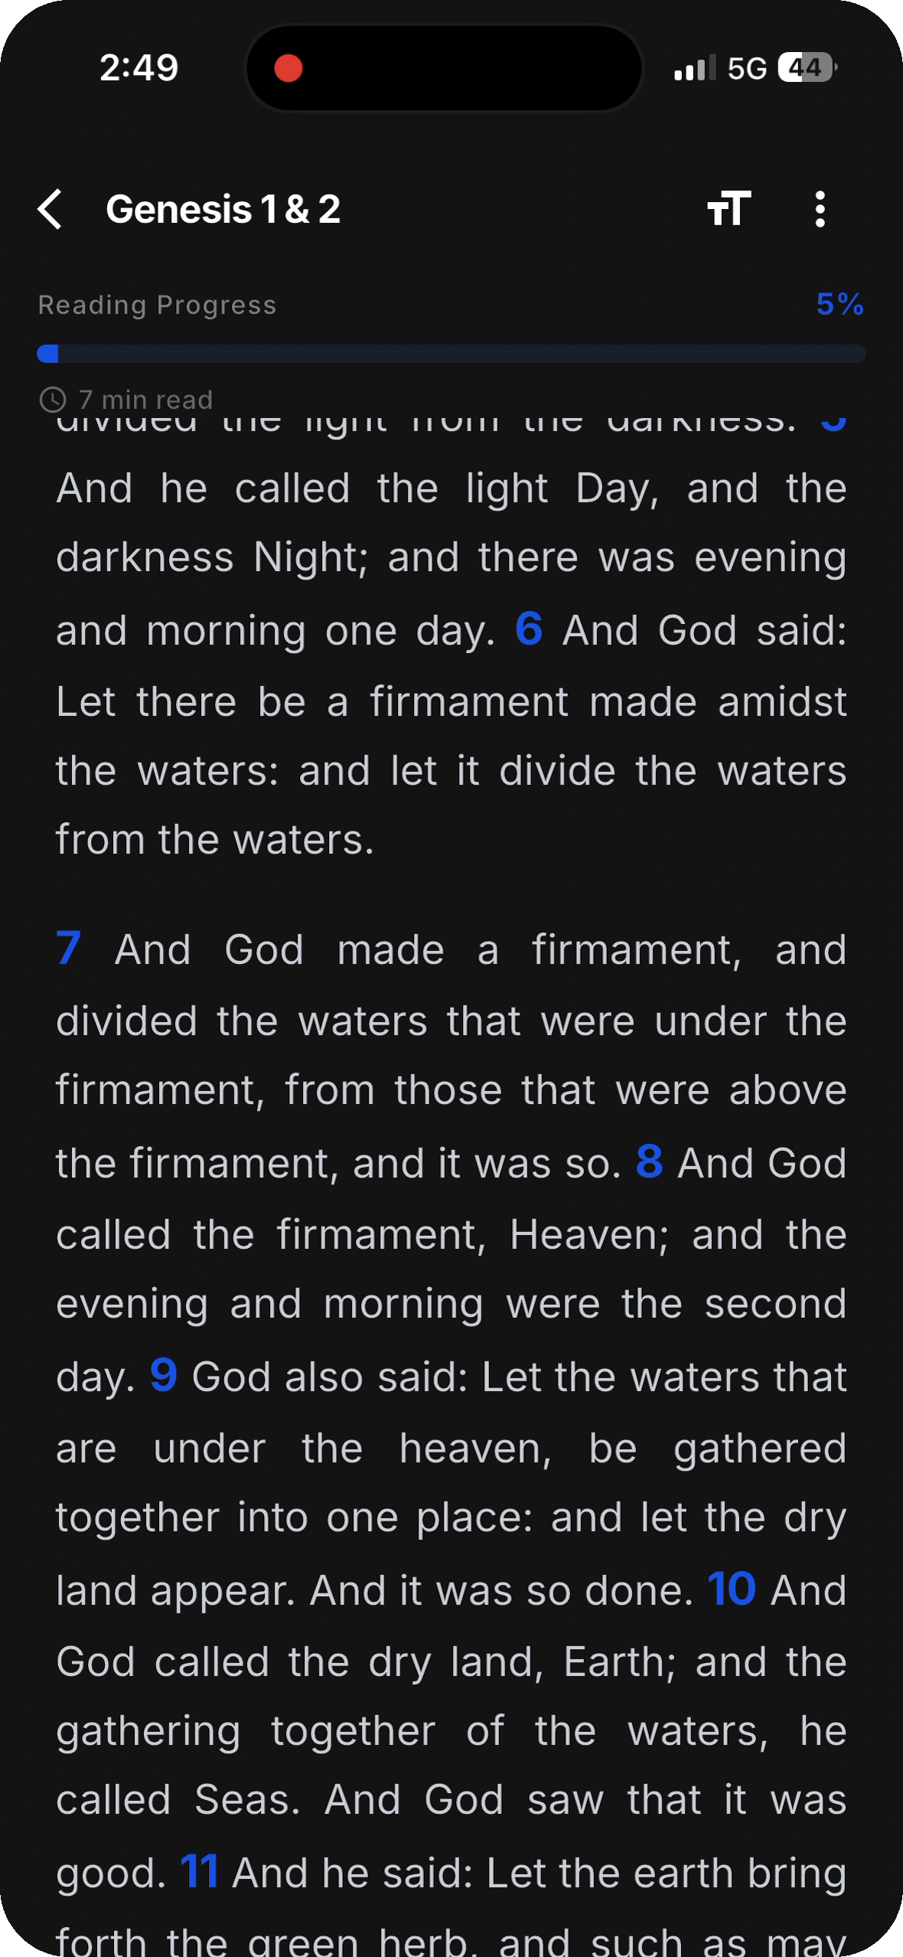
CORE EXPERIENCE
A Focused Reading Experience
HOW IT WORKS
• Clean, distraction-free reader with adjustable text and a live progress bar.
• Each daily portion is scoped to the exact verses for that day.
• An estimated read time sets a clear, achievable goal.
IMPACT
Readers always know exactly what to read and how long it takes — daily Scripture becomes effortless.
Daily Bible Reading Mission
1

Slide 4
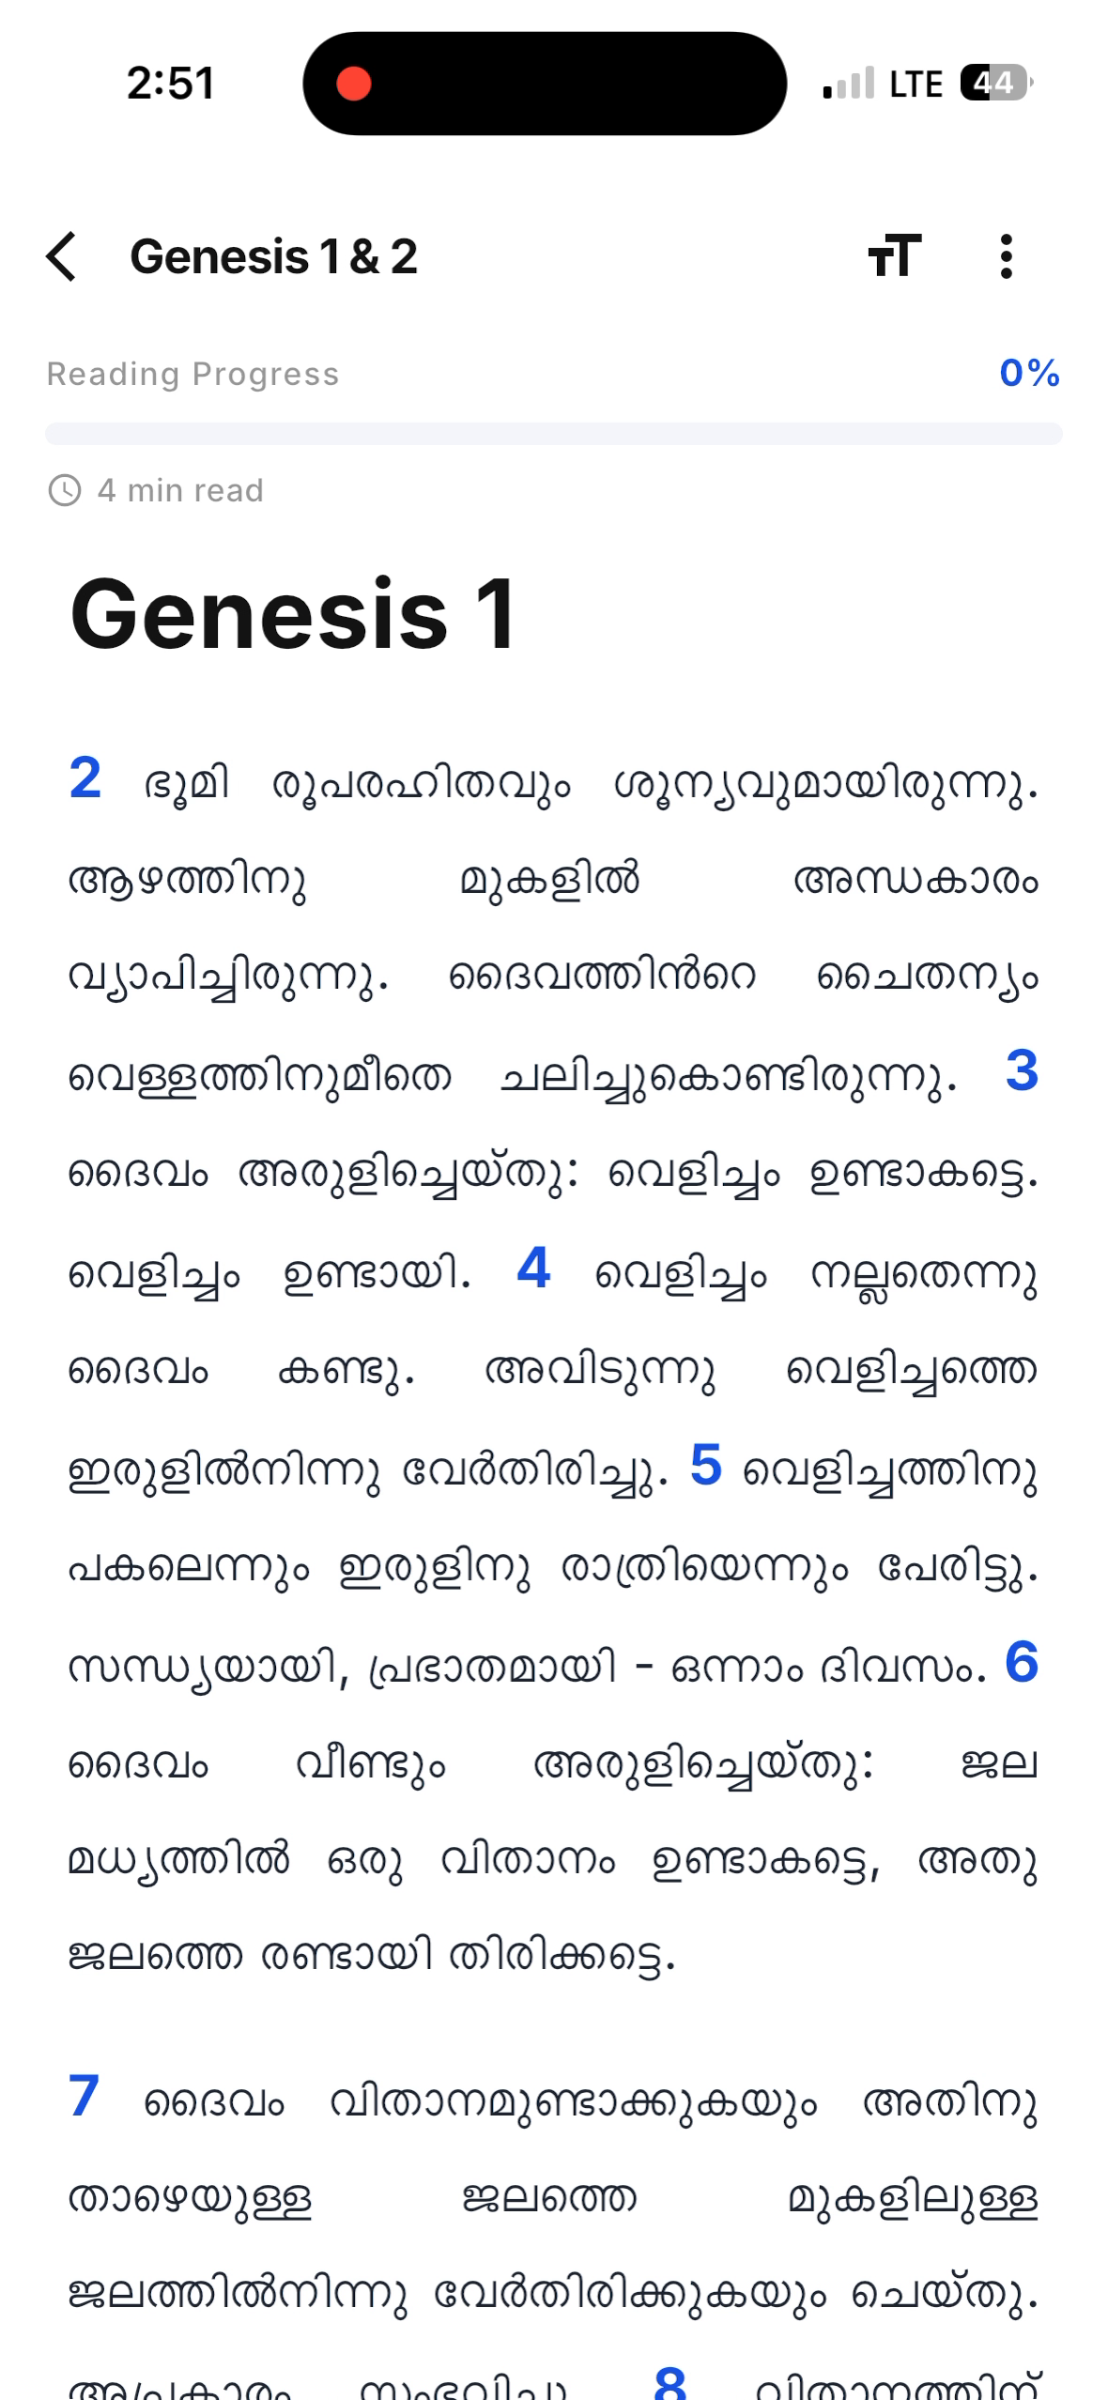
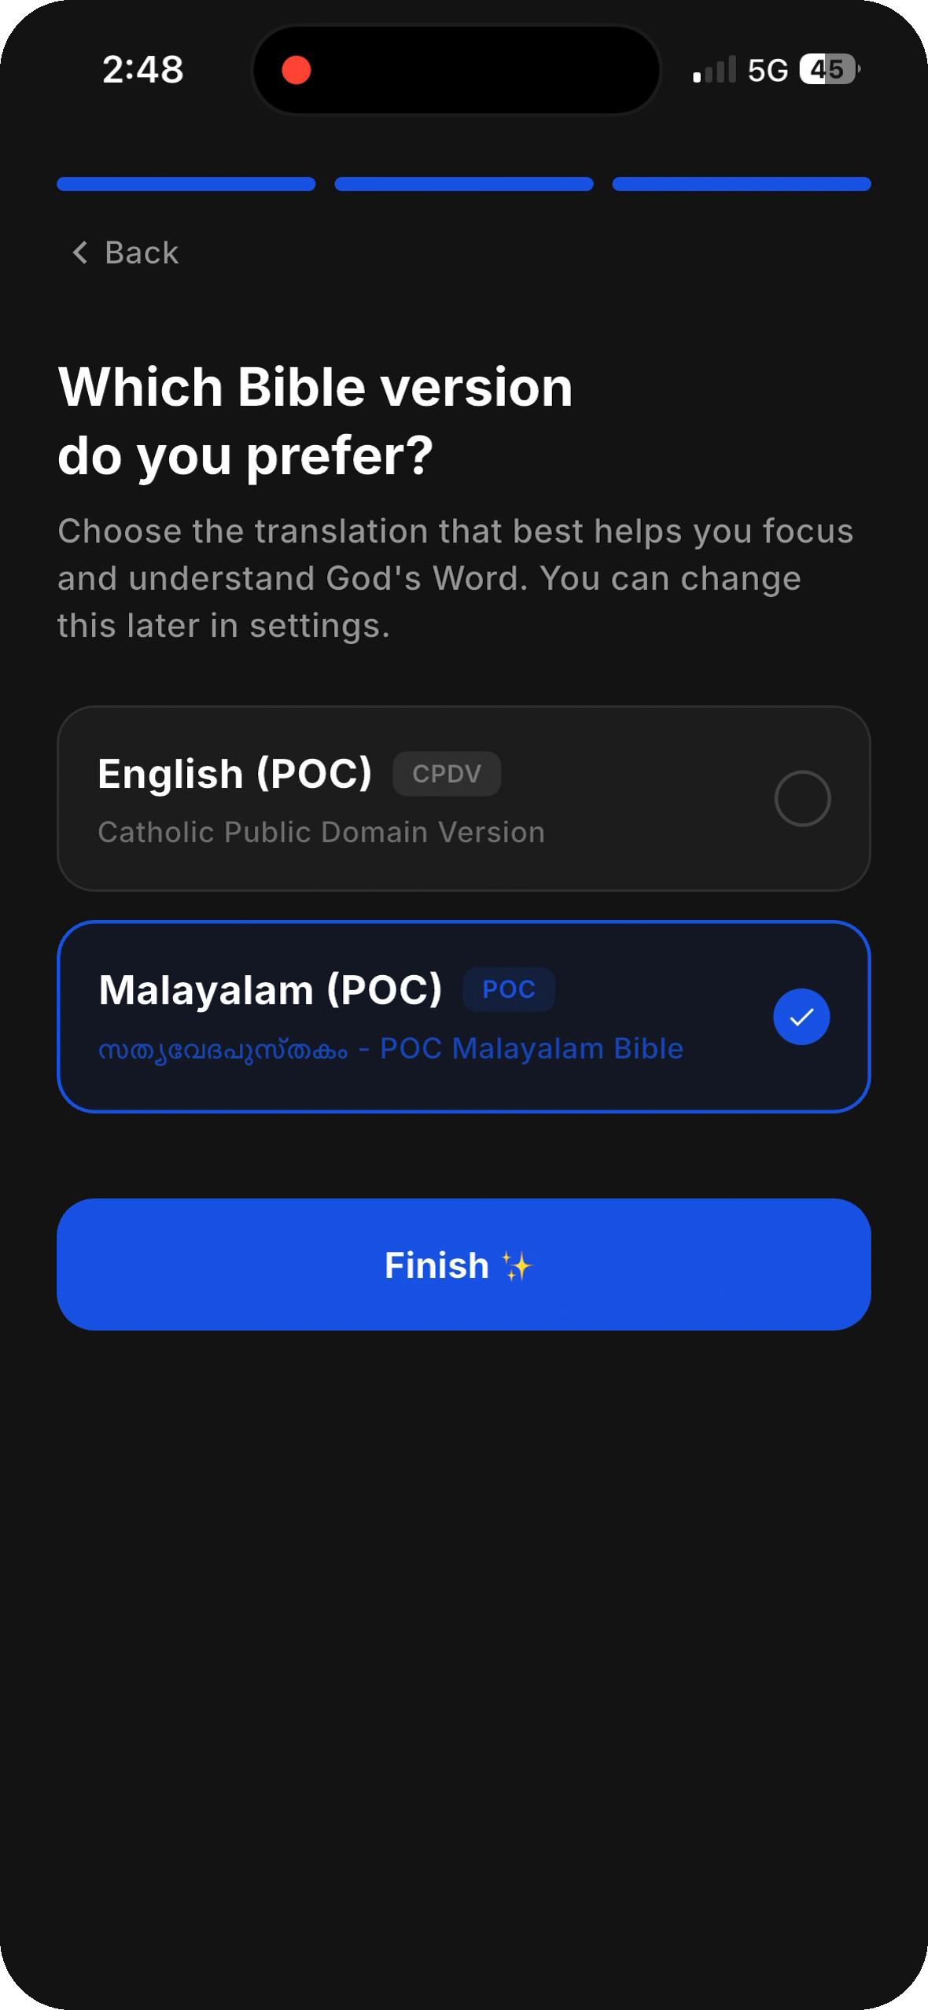
ACCESSIBILITY
Bilingual — English & Malayalam
HOW IT WORKS
• Full Catholic-canon Bible in English (CPDV) or Malayalam (POC).
• Switch translations anytime; each downloads for offline reading.
• Same plan, same verses — in the reader's heart language.
IMPACT
Opens daily Scripture to Malayalam-speaking communities, not just English readers.
Daily Bible Reading Mission
2

Slide 5
Engage
Turn reading into reflection and habit

Slide 6
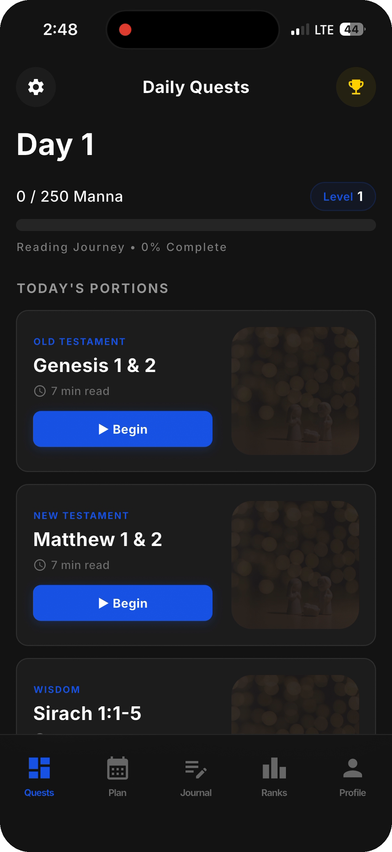
DAILY ENGAGEMENT
Gamified Daily Quests
HOW IT WORKS
• Each day opens to three reading 'quests' — Old Testament, New Testament & Wisdom.
• Earn Manna (XP), level up, and watch a live Reading-Journey bar fill.
• A daily streak counter rewards showing up every day.
IMPACT
Turns daily Bible reading into a rewarding, habit-forming routine — not a chore.
Daily Bible Reading Mission
3

Slide 7
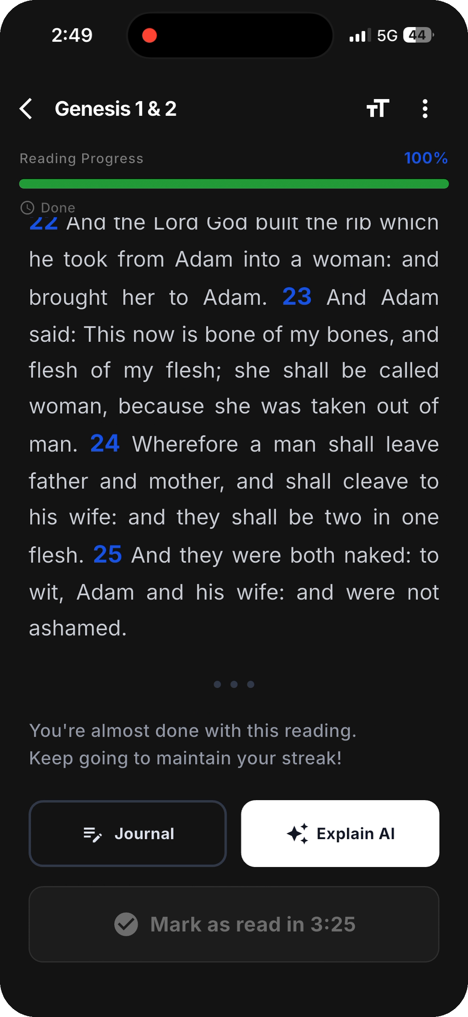
ENGAGE & REFLECT
Journal & AI, Right Where You Read
HOW IT WORKS
• Tap 'Journal' to capture reflections without leaving the passage.
• 'Explain AI' provides context and meaning on demand.
• A gentle reading timer encourages real focus before marking complete.
IMPACT
Moves readers from passive reading to active reflection and understanding.
Daily Bible Reading Mission
4

Slide 8
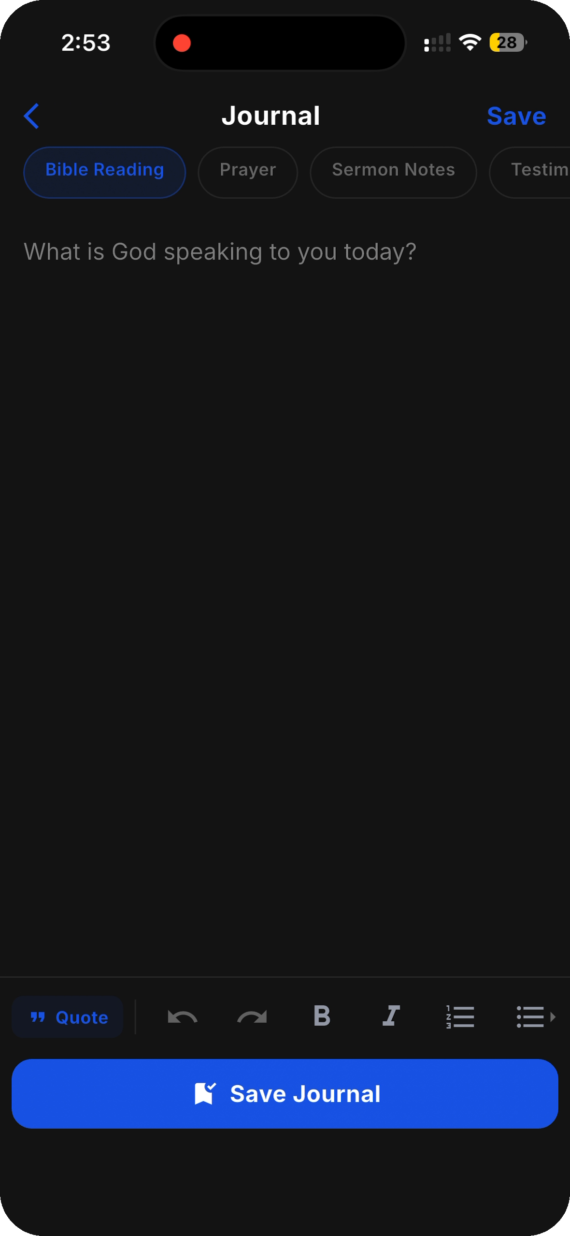
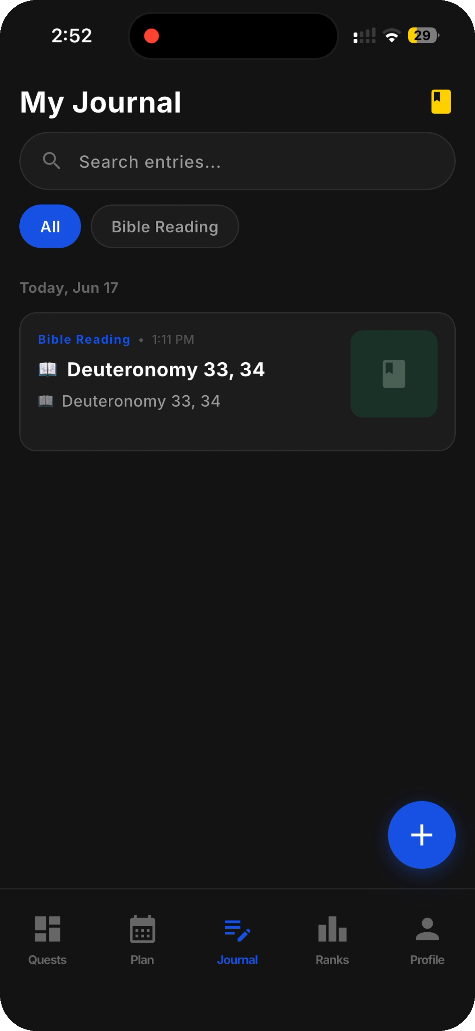
PERSONAL GROWTH
Reflective Journaling
HOW IT WORKS
• Rich-text journal with Bible Reading, Prayer and Sermon Notes templates.
• Prompted by 'What is God speaking to you today?'
• Every entry is saved, searchable and tied to the day's reading.
IMPACT
Builds a personal, lasting record of spiritual growth across the year.
Daily Bible Reading Mission
5

Slide 9
Progress
Make consistency visible and rewarding

Slide 10
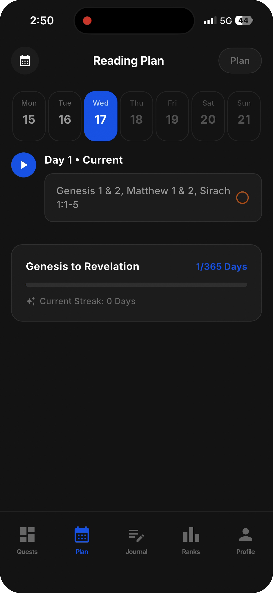
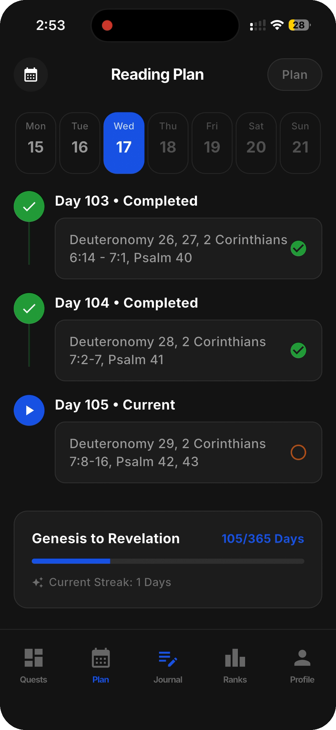
STRUCTURE
The 365-Day Reading Plan
HOW IT WORKS
• A complete 'Genesis to Revelation in one year' plan, one day at a time.
• Calendar and day-list views show done, current and upcoming days.
• Completed days are clearly marked — and the plan never runs ahead of you.
IMPACT
Gives readers a clear, finishable path through the entire Bible.
Daily Bible Reading Mission
6

Slide 11
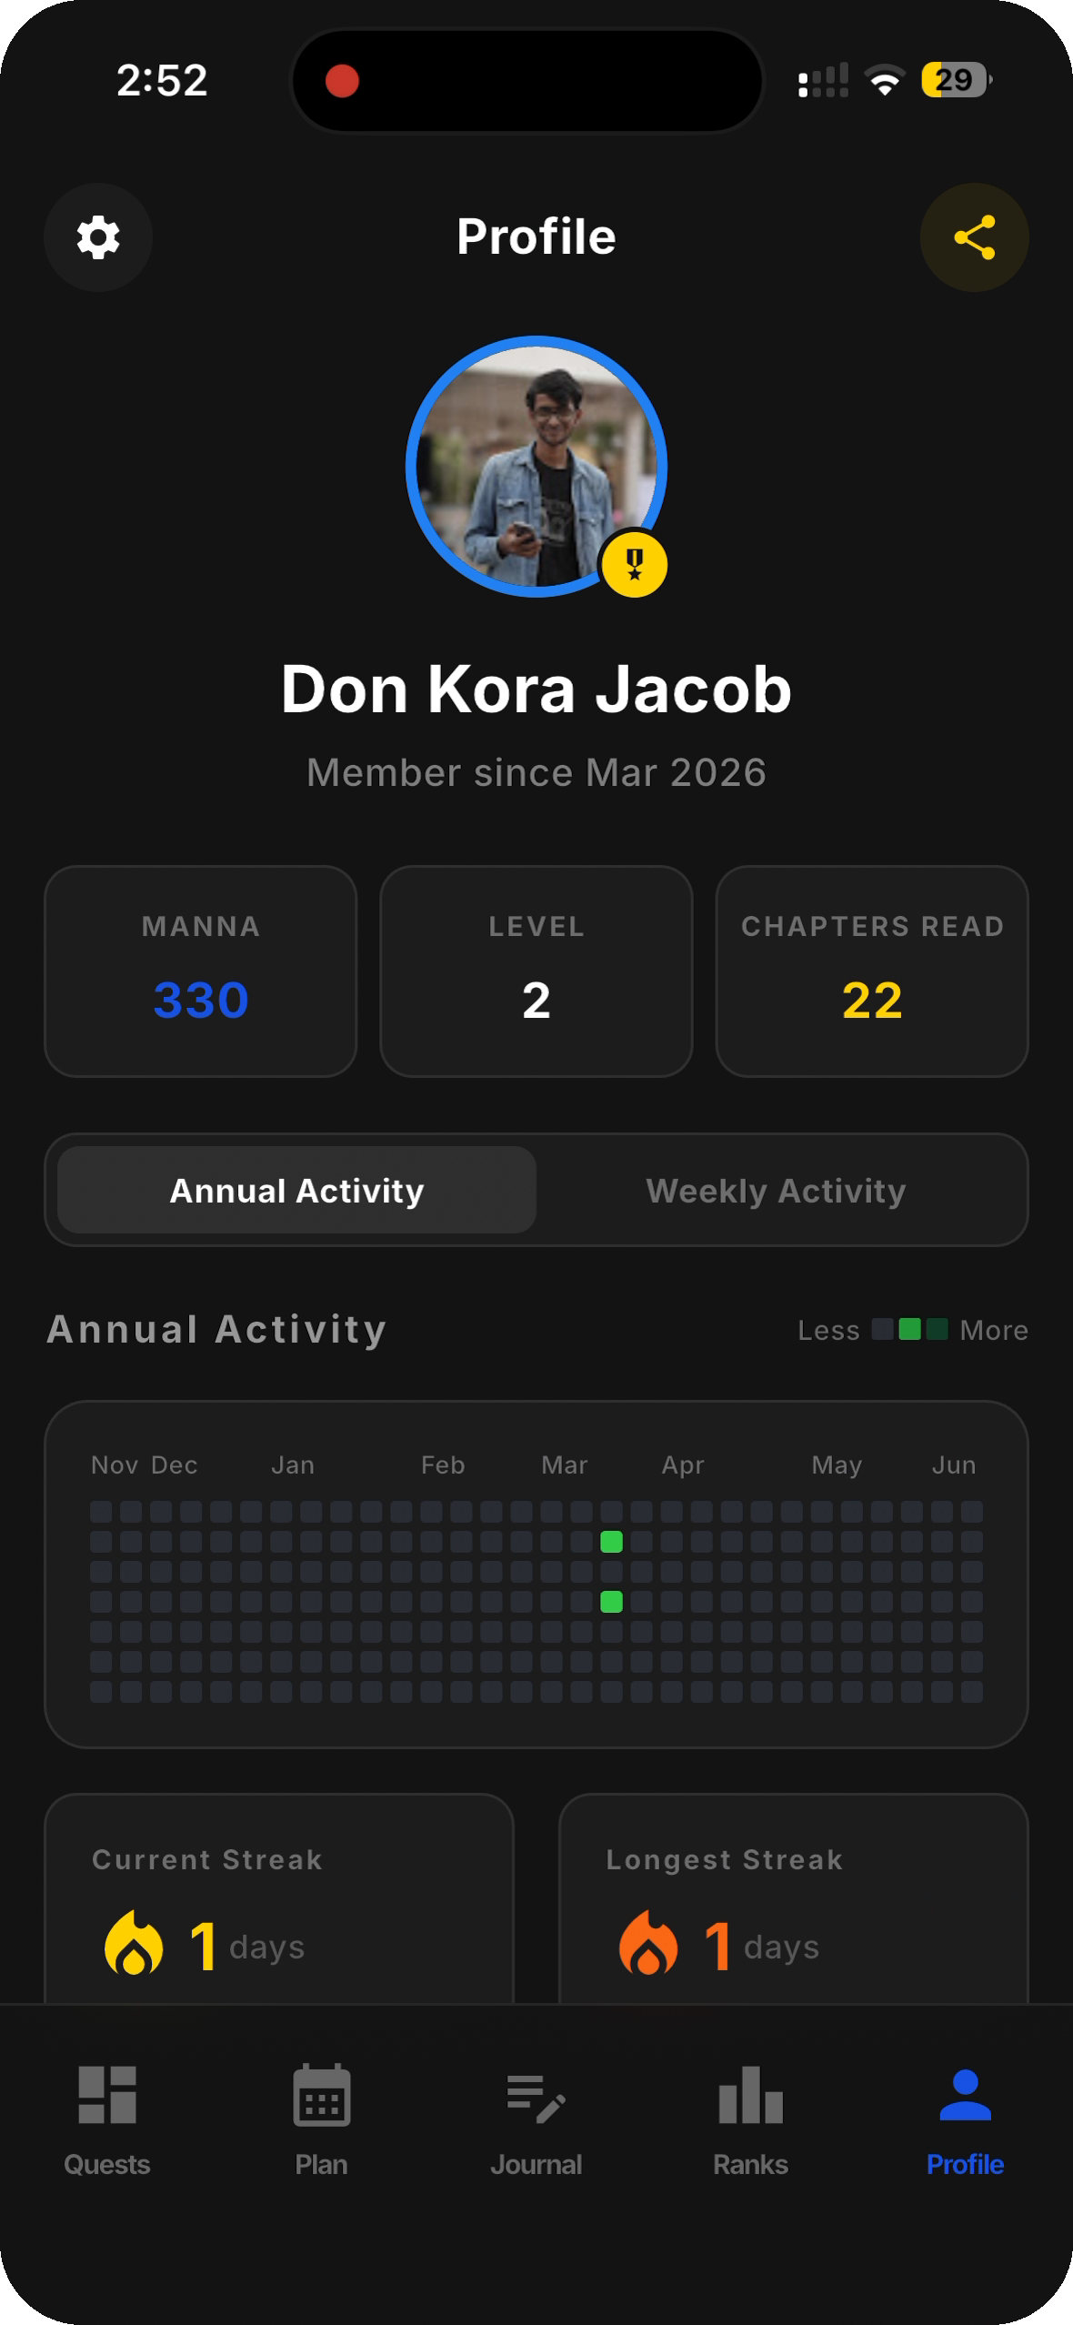
MOTIVATION
Streaks, Levels & Profile
HOW IT WORKS
• Track current & longest streaks, level, total Manna and chapters read.
• An annual activity heat-map visualizes consistency at a glance.
• Recent activity logs every completed day and reward earned.
IMPACT
Makes progress personal and visible — a powerful reason to keep going.
Daily Bible Reading Mission
7

Slide 12
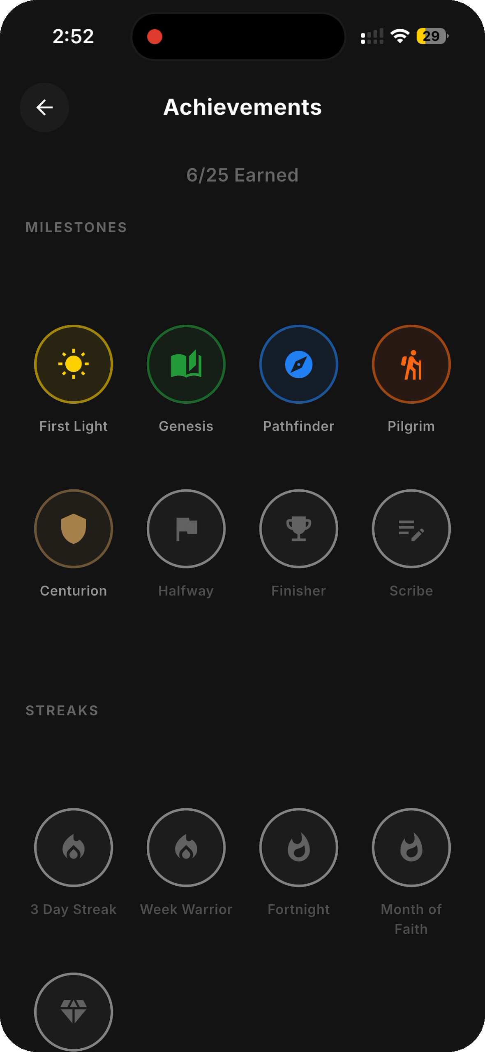
REWARDS
Achievements & Badges
HOW IT WORKS
• Unlock milestone, streak and level badges as you read.
• Clear targets to chase: First Light, Genesis, Pathfinder, Centurion…
• Earned vs. locked badges give a sense of journey and goals.
IMPACT
Sustains long-term engagement with meaningful, faith-themed rewards.
Daily Bible Reading Mission
8

Slide 13
Community
Read together, stay accountable

Slide 14
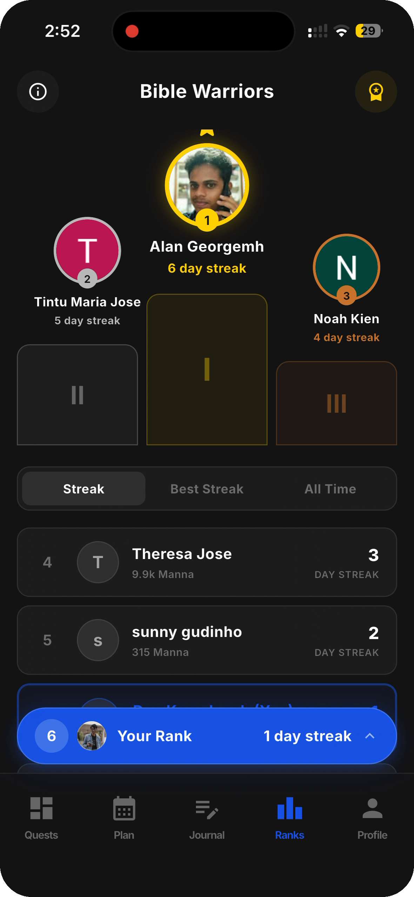
COMMUNITY
Bible Warriors Leaderboard
HOW IT WORKS
• Ranks readers by streak, best streak and all-time Manna.
• Privacy-first: hidden by default — opt in to appear.
• See your rank and stay motivated alongside others.
IMPACT
Adds friendly, opt-in social accountability that drives daily return.
Daily Bible Reading Mission
9

Slide 15
Get started & personalize
A tailored setup and full control

Slide 16
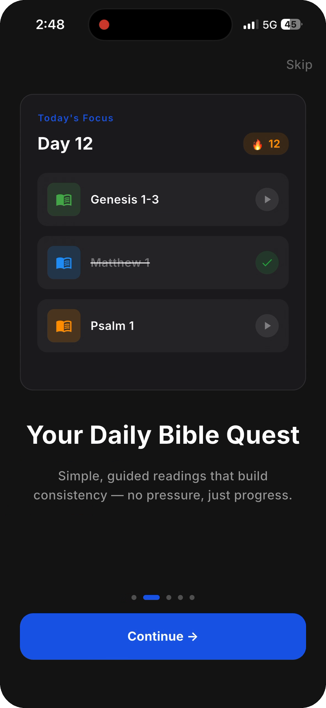
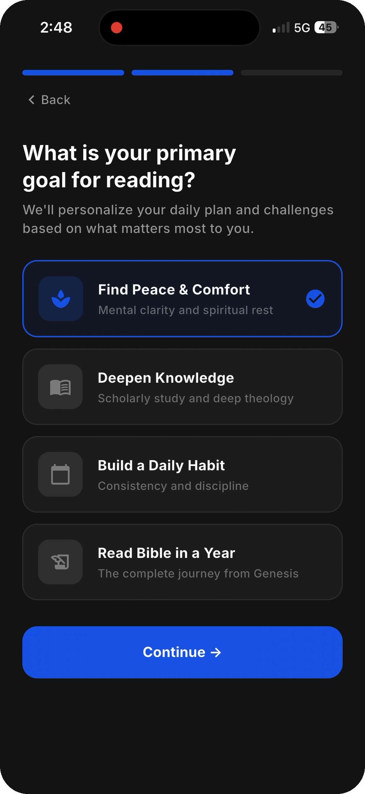
FIRST IMPRESSION
Personalized Onboarding
HOW IT WORKS
• A guided intro sets the vision and shows the daily-quest format.
• Readers pick reading goals and a reminder schedule.
• They choose their Bible version before the first reading.
IMPACT
Gets every new user to a personalized, ready-to-read state in under a minute.
Daily Bible Reading Mission
10

Slide 17
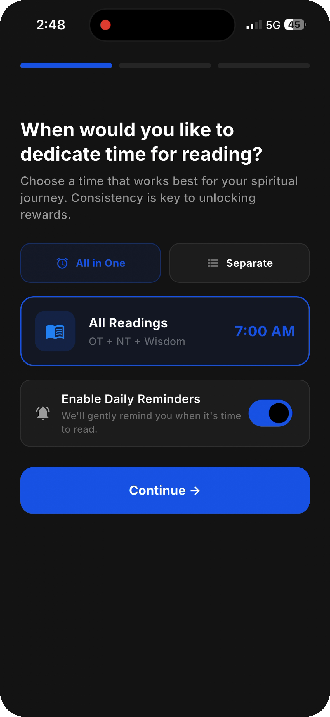
RETENTION
Smart Daily Reminders
HOW IT WORKS
• Choose all-in-one or separate reminders for each reading.
• Pick the time that fits your routine.
• Notifications carry the day's portions and estimated read time.
IMPACT
Brings readers back every day, at the moment that works for them.
Daily Bible Reading Mission
11

Slide 18
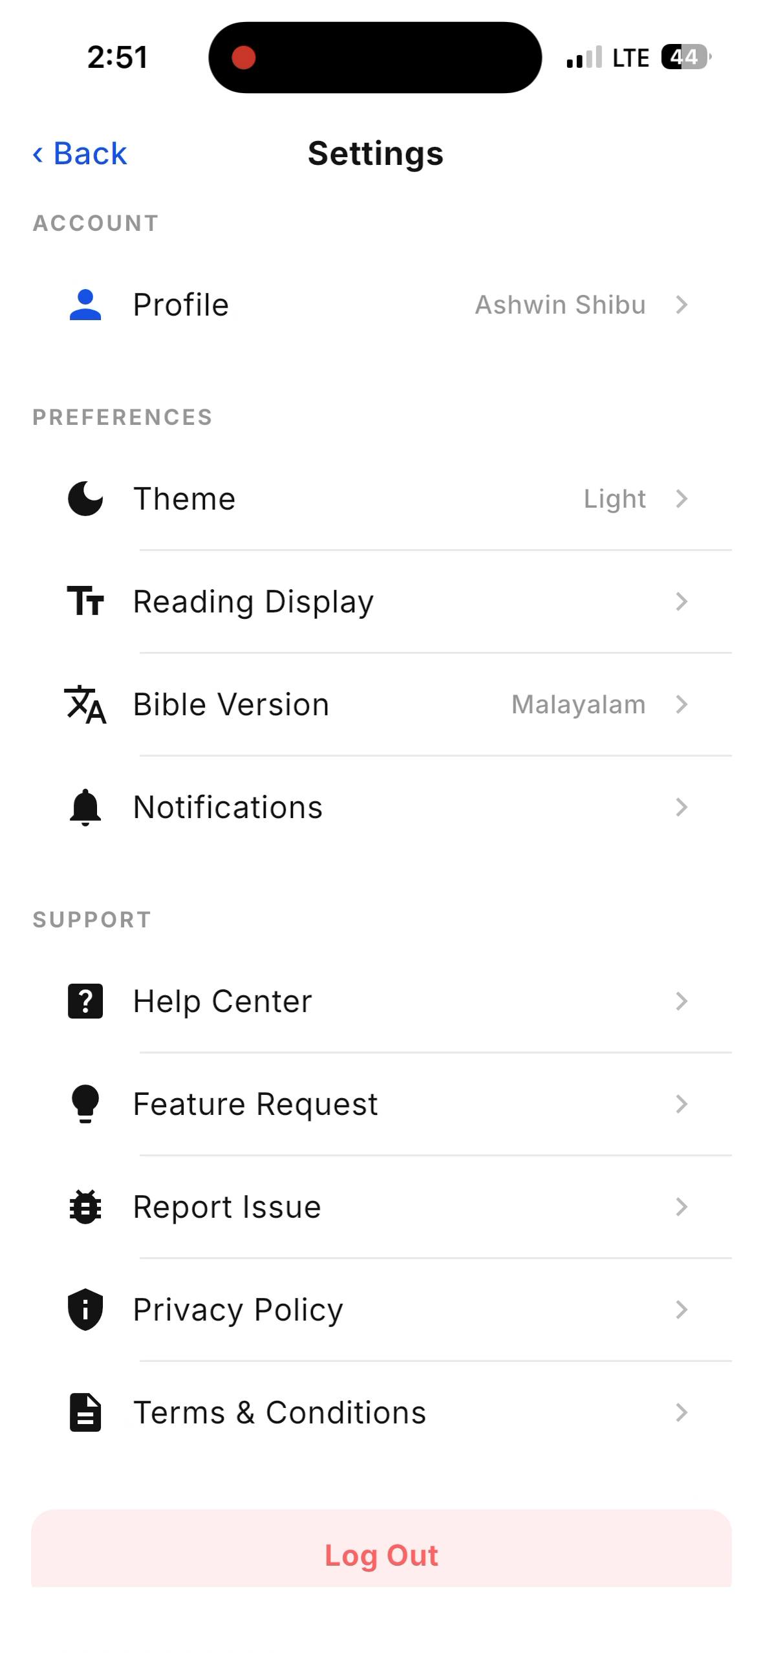
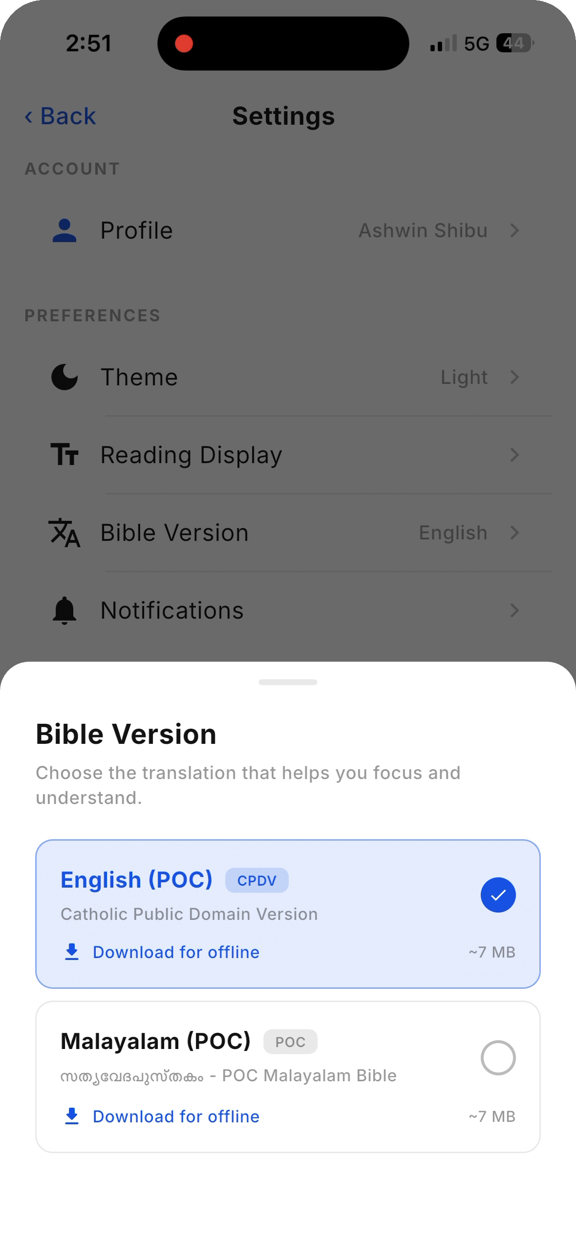
CONTROL
Settings & Personalization
HOW IT WORKS
• Switch theme (System / Light / Dark) — your choice is remembered.
• Change Bible version and reading display anytime.
• Manage notifications, profile and support in one place.
IMPACT
Lets every reader tune the app to their own preference and device.
Daily Bible Reading Mission
12

Slide 19
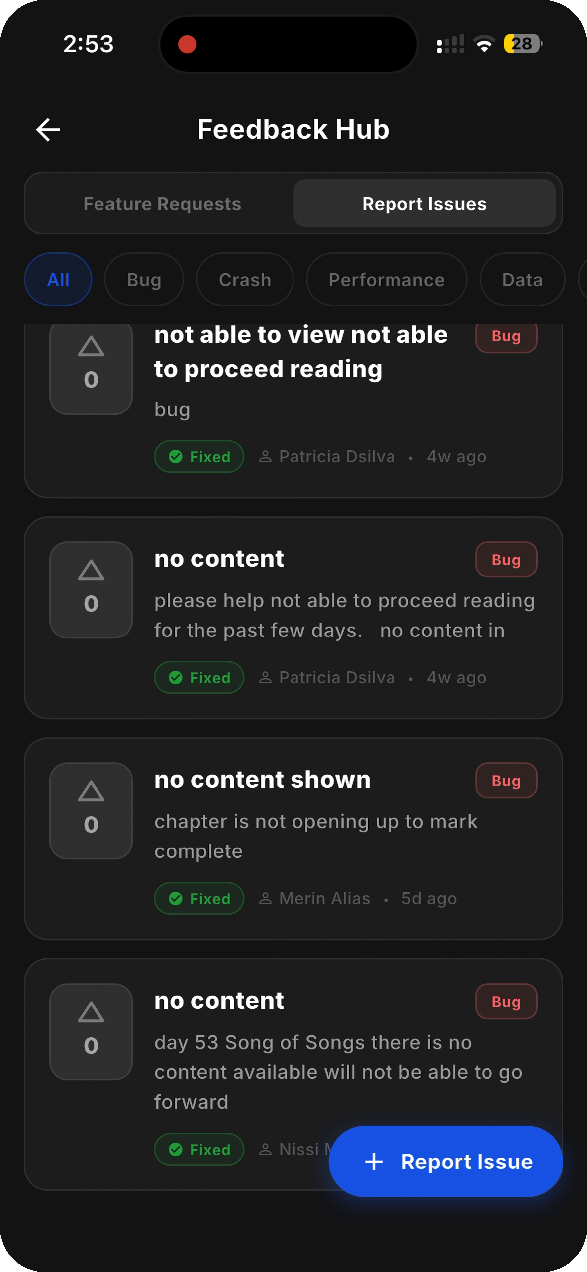
TRUST & ITERATION
In-App Feedback Hub
HOW IT WORKS
• Readers report issues, request features, and upvote others'.
• Each issue shows a live status — Open or Fixed — GitHub-style.
• The team resolves items and marks them Fixed from the backend.
IMPACT
Builds trust: users see their feedback heard, tracked and resolved.
Daily Bible Reading Mission
13

Slide 20
One habit. The whole Bible.
In your language.
Gamified daily quests · bilingual reading · journaling · AI explanations · streaks ·
achievements · community leaderboard · a 365-day plan, Genesis to Revelation.
DAILY BIBLE READING MISSION

